Slide 1
Improving the University Bus Service
Group 5
Notes:
Good afternoon

Slide 2
Business case
Students are unhappy with the scheduling of the Stagecoach Unibus service:
Buses are too infrequent
Buses are too full
These are difficult problems to fix:
Buying more buses is expensive (one bus costs roughly £500,000)
It is hard to plan for demand as traffic and lecture times are unpredictable
A software solution is needed to create a smarter bus timetable
Notes:
We’re here today to pitch our solution to Stagecoaches Unibus problem. At the moment Stagecoach receives complaints from students about the U1 bus. Complaints say that buses are infrequent, with some reporting hour long waiting times, as well as the buses being full a lot of the time, requiring many students to have to stand up for a half an hour journey to University.

Slide 3
Stakeholder Benefits
Students - Reduced waiting times and more space
Stagecoach - Improved customer satisfaction and reduced competition
University - Higher attendance and student performance
Local Council - Leamington becomes more attractive for students
Notes:
The project impacts several different parties, all of which benefit from the proposed solution.
Students are heavily invested, their main benefit being able to get to more lectures on time, ultimately producing a better grade.
Stagecoach is the key stakeholder, since an improved timetable increases customer satisfaction leading to an overall profit.

Slide 4
Proposed solution
Collect timetable and room booking data from university
Collect live traffic data
Develop algorithm for predicting journey times
Use algorithm to create new timetable
Integrate timetable with stagecoach app
Notes:
Solution solves issues by optimising schedule
Collect student and traffic data
Create algorithm to optimise schedule
Integrate new timetable with app

Slide 5
Work Breakdown Structure
4 Additional Work Packages
4.1 Improve quality and accuracy of algorithm
Improving the Bus Service
4.2 GPS bus detection for Stagecoach app
1 Develop Scheduling Algorithm
2 Create Optimised Timetable
3 Stagecoach App Integration
1.1 Get timetable data from University
2.1 Collate traffic and lecture time data
3.1 Define app requirements
1.2 Get live traffic data
2.2 Analyse data using algorithm
3.2 Develop code to be added
1.3 Create algorithm to predict journey time in the near future
2.3 Test timetable at off-peak times
3.3 Integrate and test additional code
2.4 Review testing and integrate timetable
3.4 Roll out update to users
Notes:
3 work packages
First, develop algorithm
Will allow work package 2, developing a new timetable
Work package 3, develop stagecoach app with timetable

Slide 6
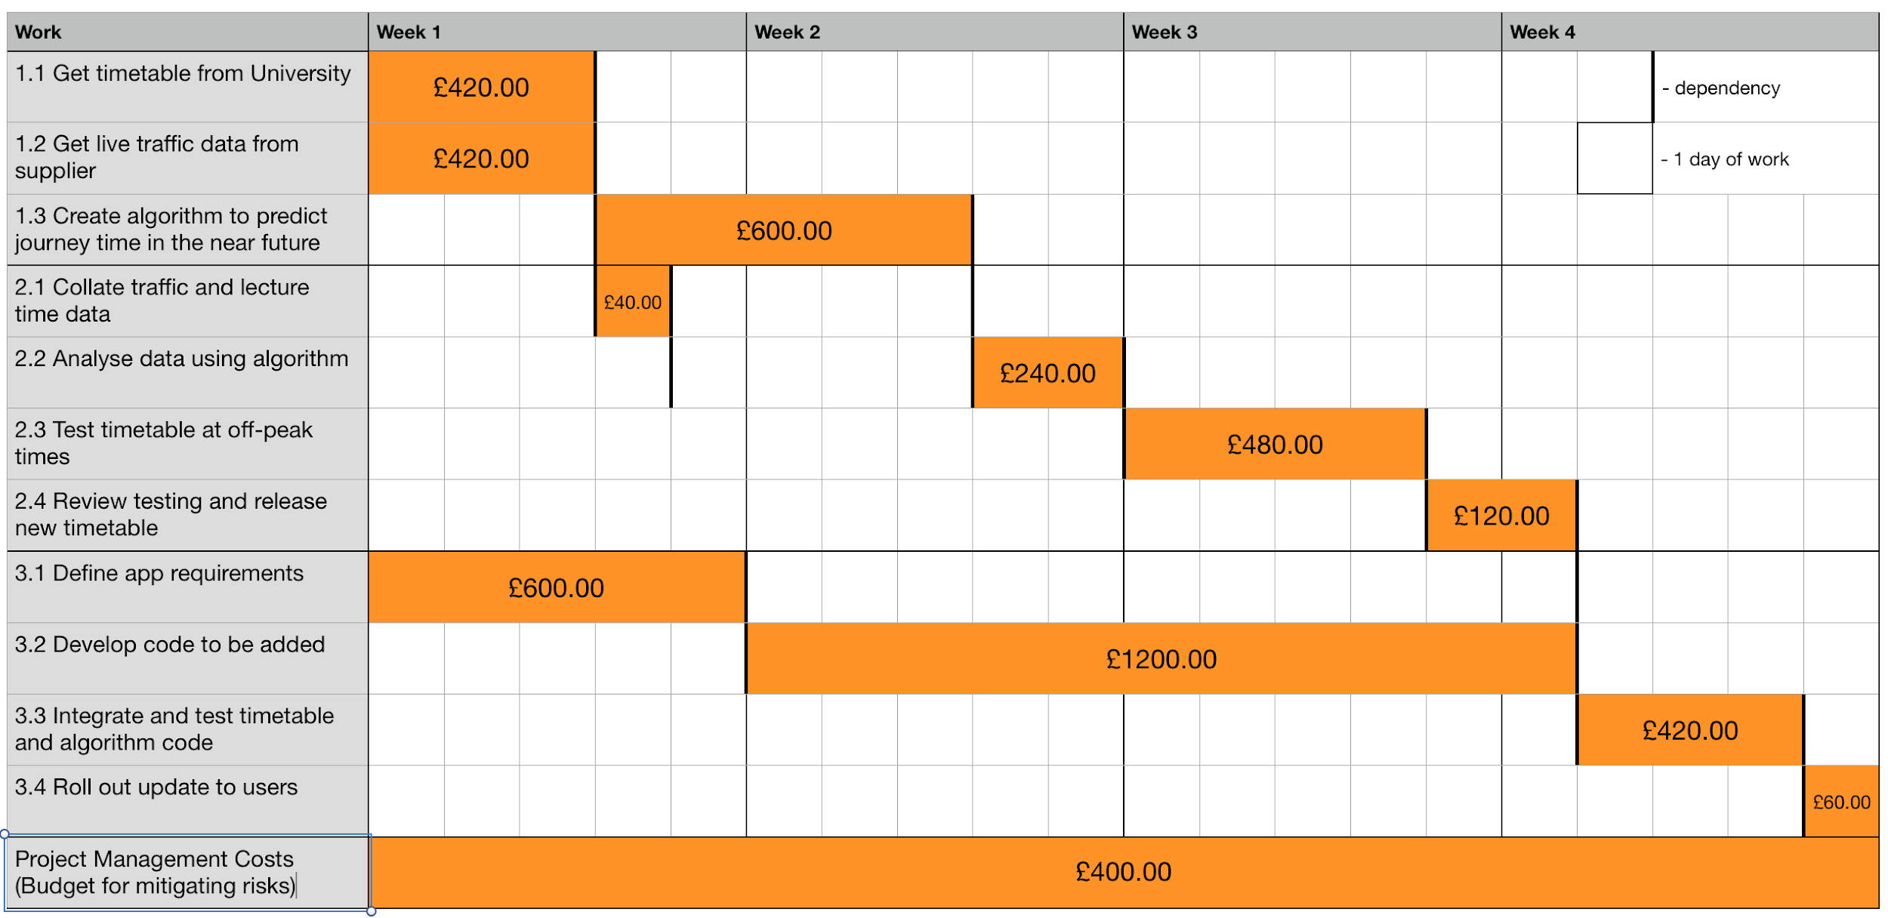
Timeline and Budget
Notes:
Work packages scheduled with budget attached
Shows the project can be on-time and on-budget
£400 budgetted for project management costs, risks for example

Slide 7
Extra Potential
In addition to our core project, we offer a range of choices and flexibility with regards to functionality
Increased Budget:
Improved quality and accuracy of the algorithm
More detailed bus information on the stagecoach app
Show current capacity of buses
GPS Implementation in buses:
More accurate prediction of journey times
Students able to plan journeys better due to lower wait times
Potential for continued development at your convenience
Notes:
There are 3 opportunities for extra potential. A bigger budget allows extra features and more accurate algorithm, and so does continued support from stagecoach. Additionally, allowing the use of gps data could also have a big impact on the quality of the solution.

Slide 8
Project Methodology
Agile Manifesto puts emphasis on working software, customer collaboration and responding to change
Proposed methodology is scrum:
Increases team accountability through daily stand ups
Weekly sprints make it easier to accommodate changes
Notes:
Agile is more appropriate than traditional methodology
Increased team accountability is beneficial due to short time frame
Easy to accommodate changes which allows for a flexible scope

Slide 9
Risk Matrix
 | Negligible | Minor | Moderate | Significant | Severe
Very Likely
Likely
Possible | Traffic increases at peak times due to rescheduling |  |  |  | Bus drivers striking due to GPS implementation
Unlikely |  |  |  | Customers dissatisfied with changes
Very Unlikely |  |  | Development goes over-budget
Notes:
Major risks:
GPS implementation may cause bus drivers to strike: severe financial consequences
Customers may be unhappy with changes to timetable and user interface of stagecoach app
Smaller risks:
Budget small so can go over-budget
Traffic actually increases due to more buses

Slide 10
Risk Responses
Drivers striking if GPS is integrated
Offer them more paid breaks, flexible break times if GPS implemented from time gained by timetable
Customers dissatisfied with changes
Take customer feedback throughout development process, can easily switch between systems quickly
Development goes over-budget
Reduce risk by Estimated Value Analysis of deliverables throughout
Accept other insignificant risks

Slide 11
Summary
Benefits relevant parties greatly
Freedom of choice with project scope
All major risks mitigated
NO REASON NOT TO INVEST

Slide 12
Q&A

